Slide 1
Traffic law and Fine System
PUSL2003 TEAM 02

Slide 2
PUSL2003 Team 02
GROUP DETAILS
10707140 D.M.S.H. BANDARA (SE)
10707196 L.M.N. FERNANDO (SE)
10707304 A.A.R.S.S. PERERA (SE)
10707257 T.D. LIYANAGE (SE)

Slide 3
Project Idea
We are planning to develop an application that will be given to the police officers, which can read the license card of a Driver. When the card is issued the driver is given a specific amount of points, and if a driver violates a traffic law, the police officer will scan the license card and reduce points according to the law violated. In this way if a fine is needed to be played by the drive, he can pay it directly with the police officers’ application or can pay from his nearest post office.
• an application that will be given to the police officers • can read the license card of a Driver (nfc) • with card, driver is issued points (default 10/50) • police officer will scan the license card and reduce points according to the law violated • driver can pay fine directly with the police officers’ application (or can pay from his nearest post office)

Slide 4
Project APPROCH AND DEVELOPMENT PROGRESS
For this project we are using FLUTTER as the technology which uses Dart language that is developed and maintained by Google.
We are planning to use Firebase, which is also developed by Google as the database solution for this project.
We are using NFC technology to scan the driving license and access driver database.
We are using git hub as the version control solution, and to keep the project in one place and well organized.

Slide 5
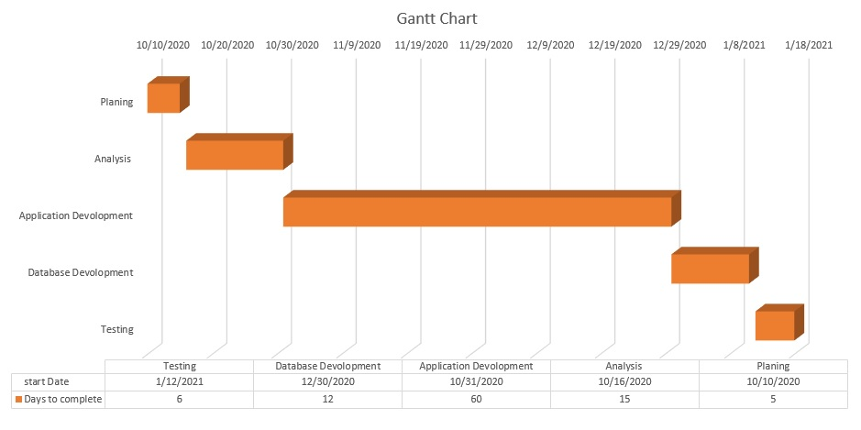
PROJECT PLAN

Slide 6
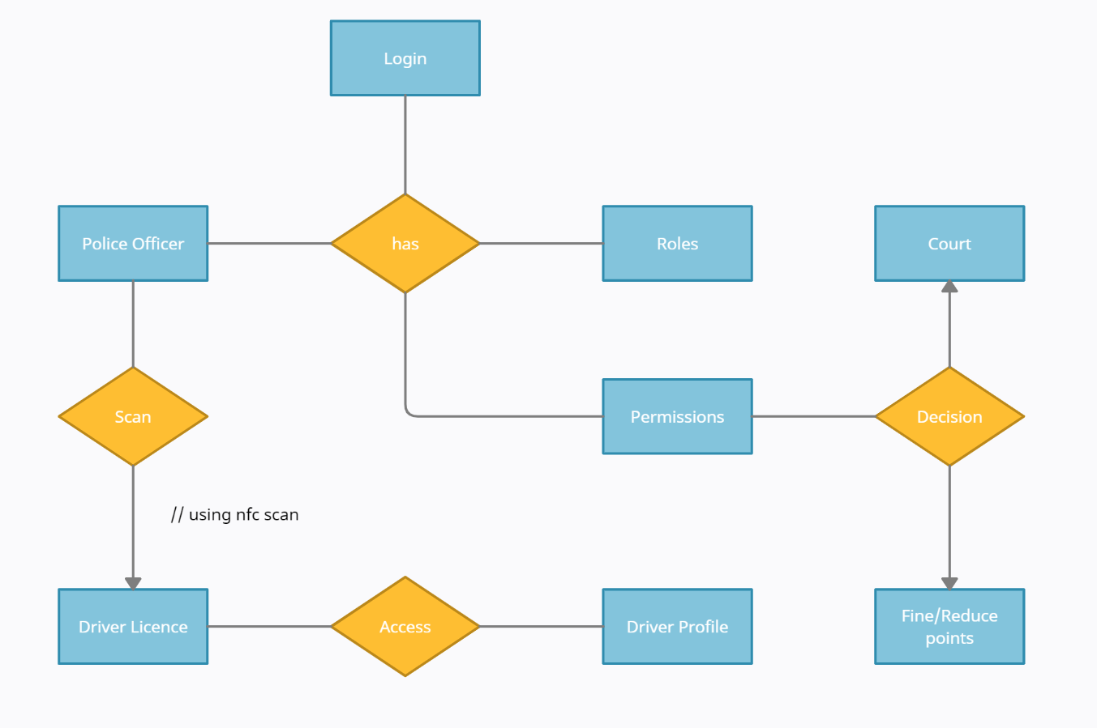
Simplified er diagram
We sketched a simplified ER diagram in order to analyze existing databases and to find and resolve problems in logic or deployment.
Goal of drawing this diagram is to have a graphical view of the system in order to track the flow of the application.
Furthermore, this diagram is used to design and analyze relational databases used in the application.

Slide 7
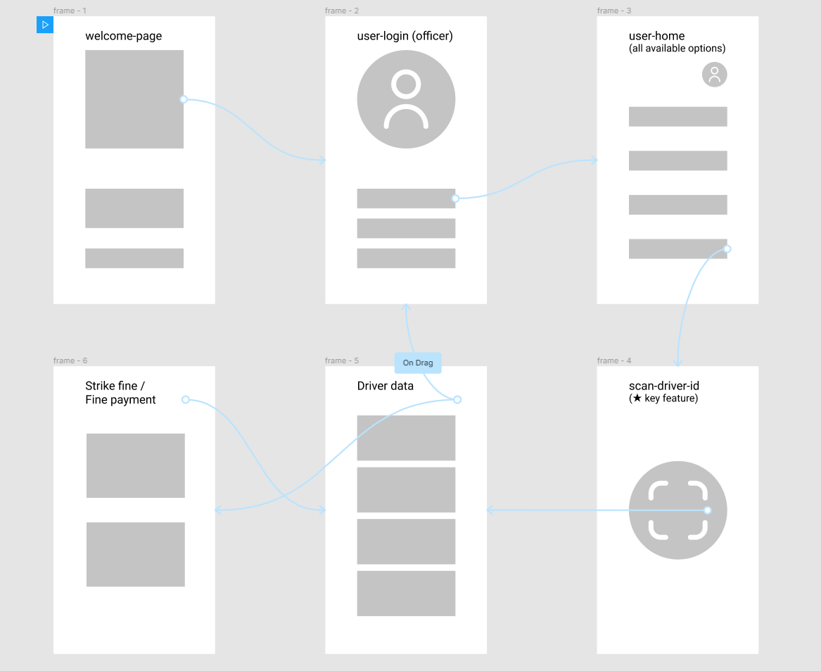
Core wireframe
The goal of this wireframe is to identify the outline of the content and create a solid foundation for future steps of the design process.
Wireframing make the visual and interaction design much easier.

Slide 8
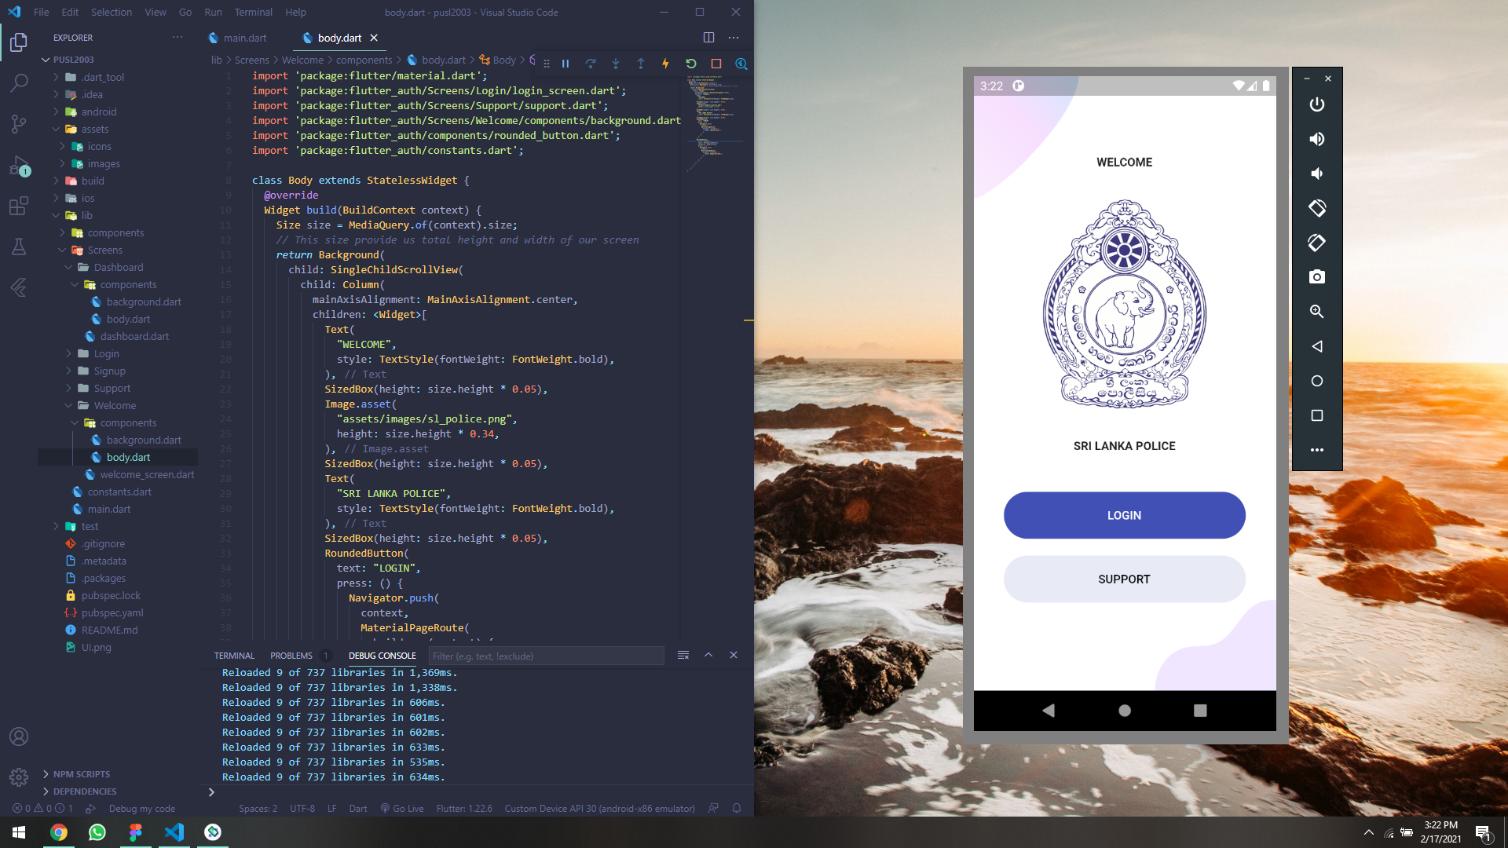

Slide 9


Slide 10
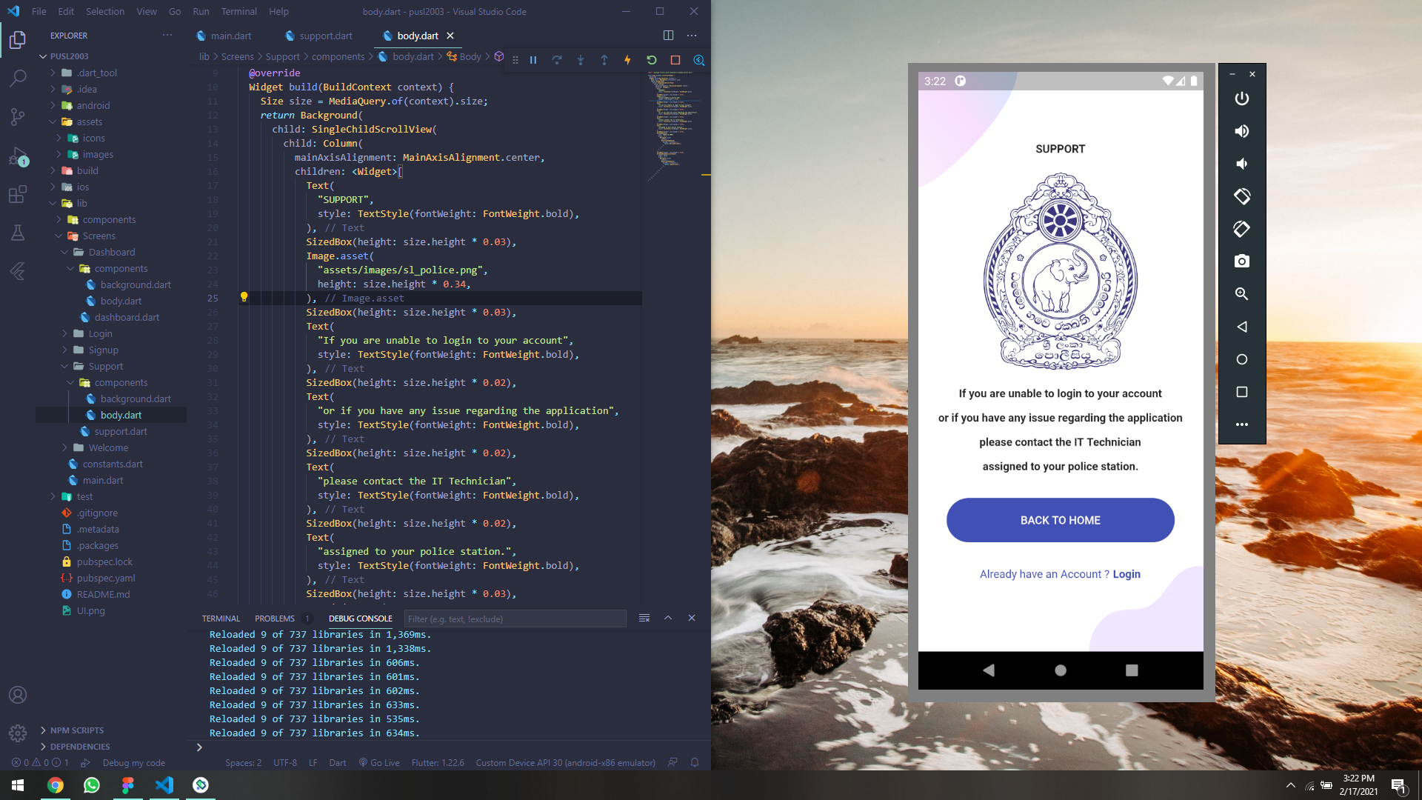

Slide 11
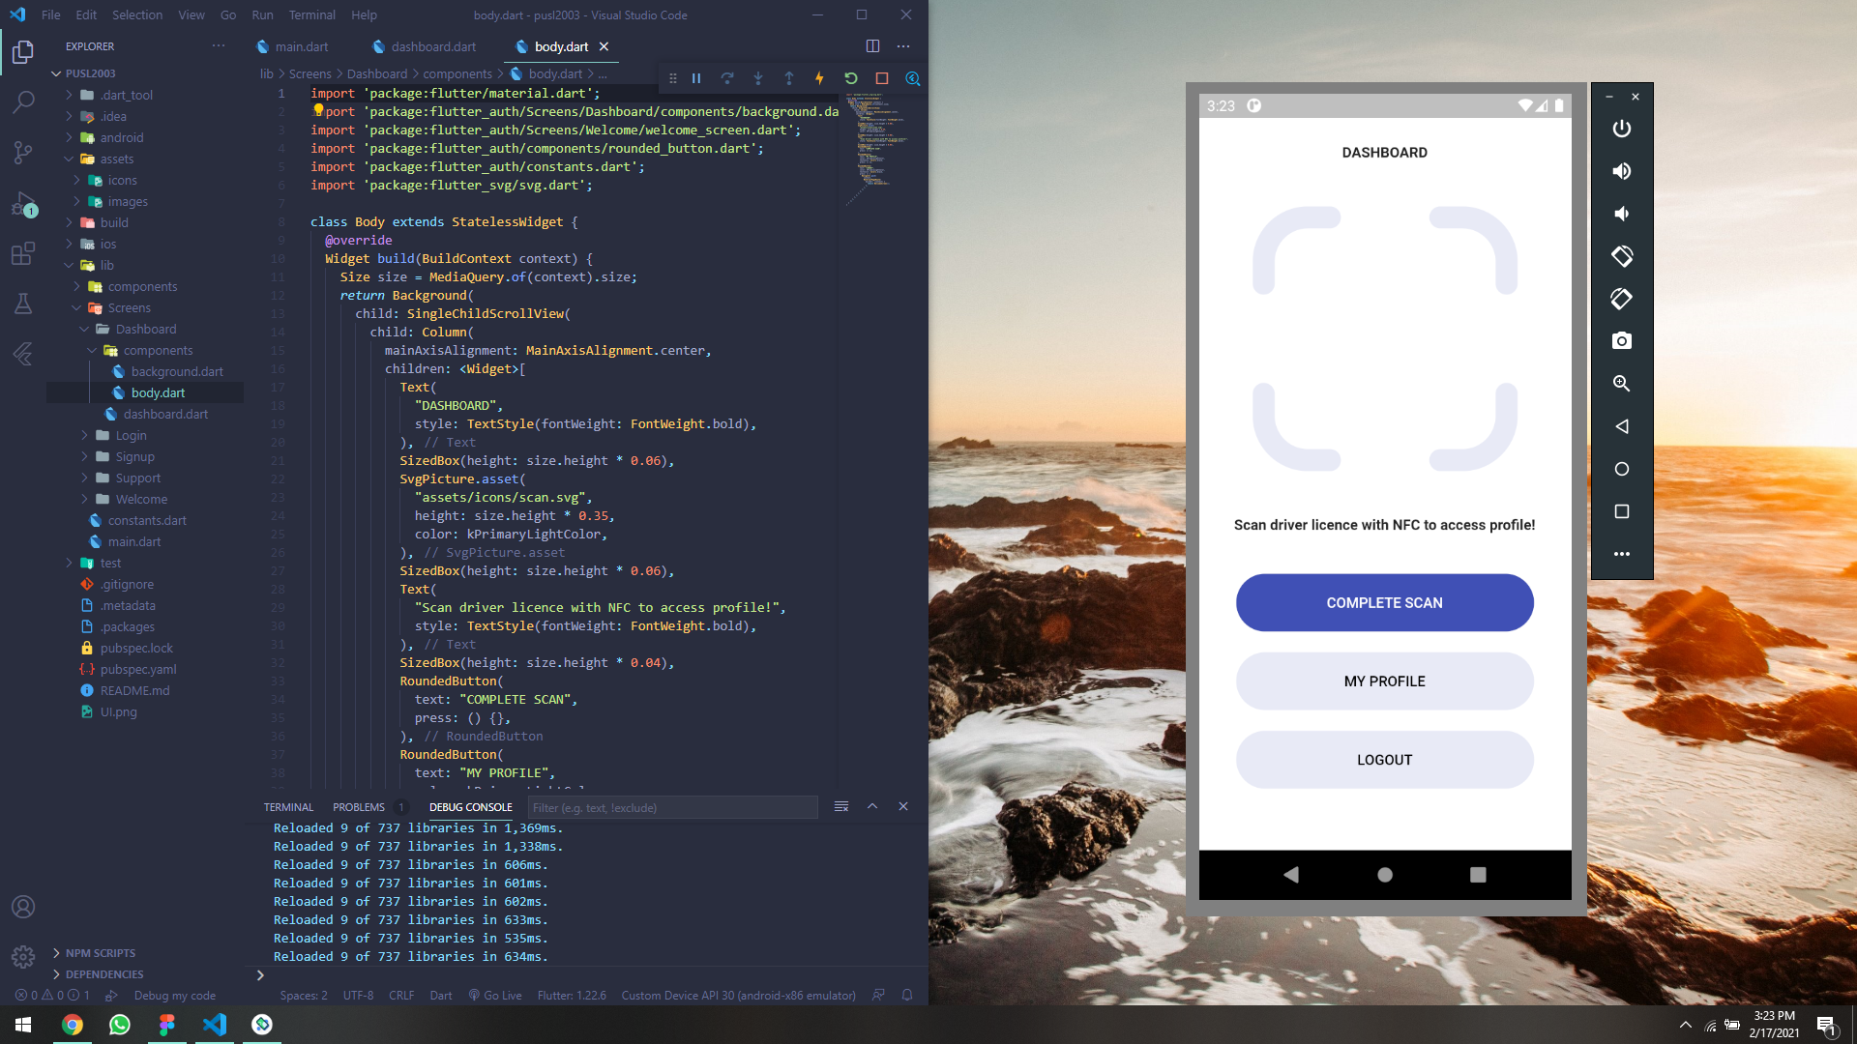

Slide 12
Current progress and yet to be achieved goals
Around 60% of the application design and development has been completed at the moment.
Database is yet to be implemented to the application using Firebase, and trough the data retrieved from the database, application functionalities must be adjusted.
NFC technology should be implemented to the project in order to receive data from driver database.
A web portal is to be implemented in order to edit and handle databases. (Firebase Console)

Slide 13
THANK YOU

